Slide 1
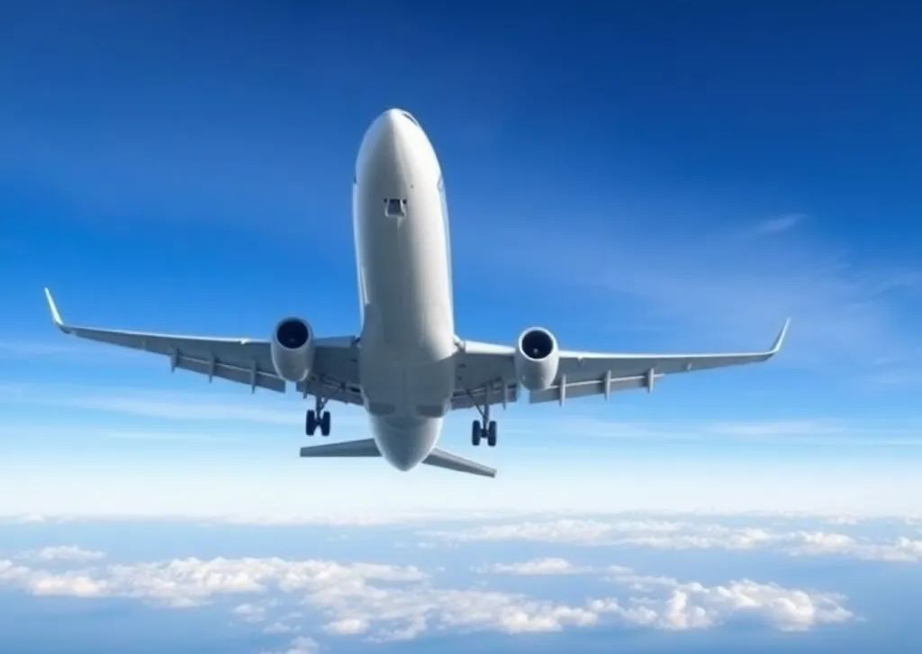
SMART Project Strategic Minimization of Airfare and Risk of Travel delays
Created By:
Michael Luc
Mandeep Kaur Sohi
Rajani Muttumula

Slide 2
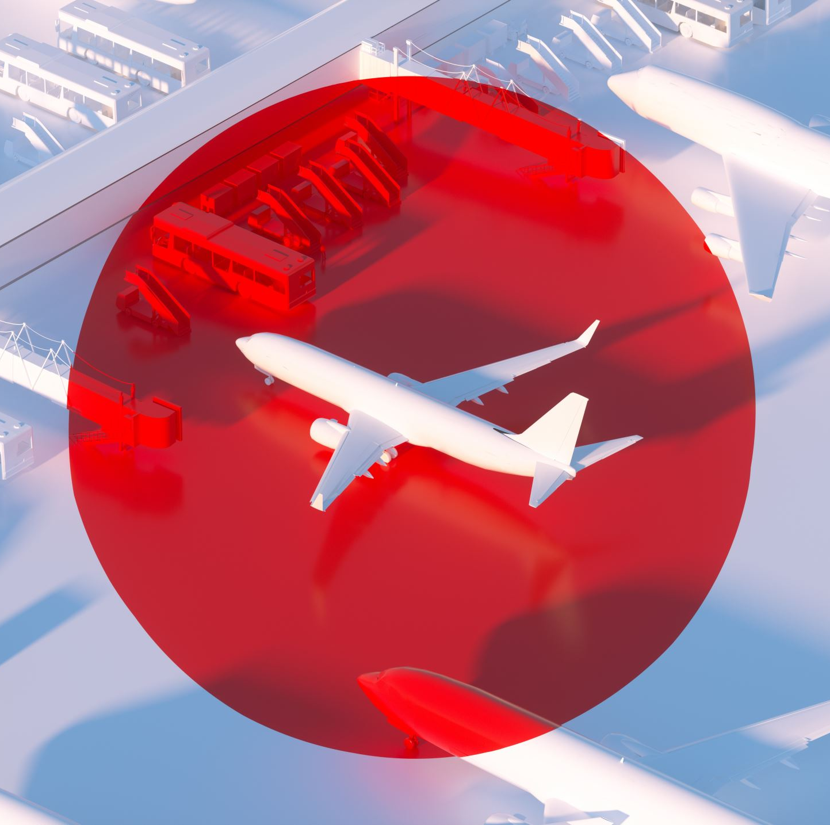
Table of Contents
Background
Our Team
Flight On-Time Analysis
Weather Analysis
Cheapest Flights Analysis
Conclusion

Slide 3
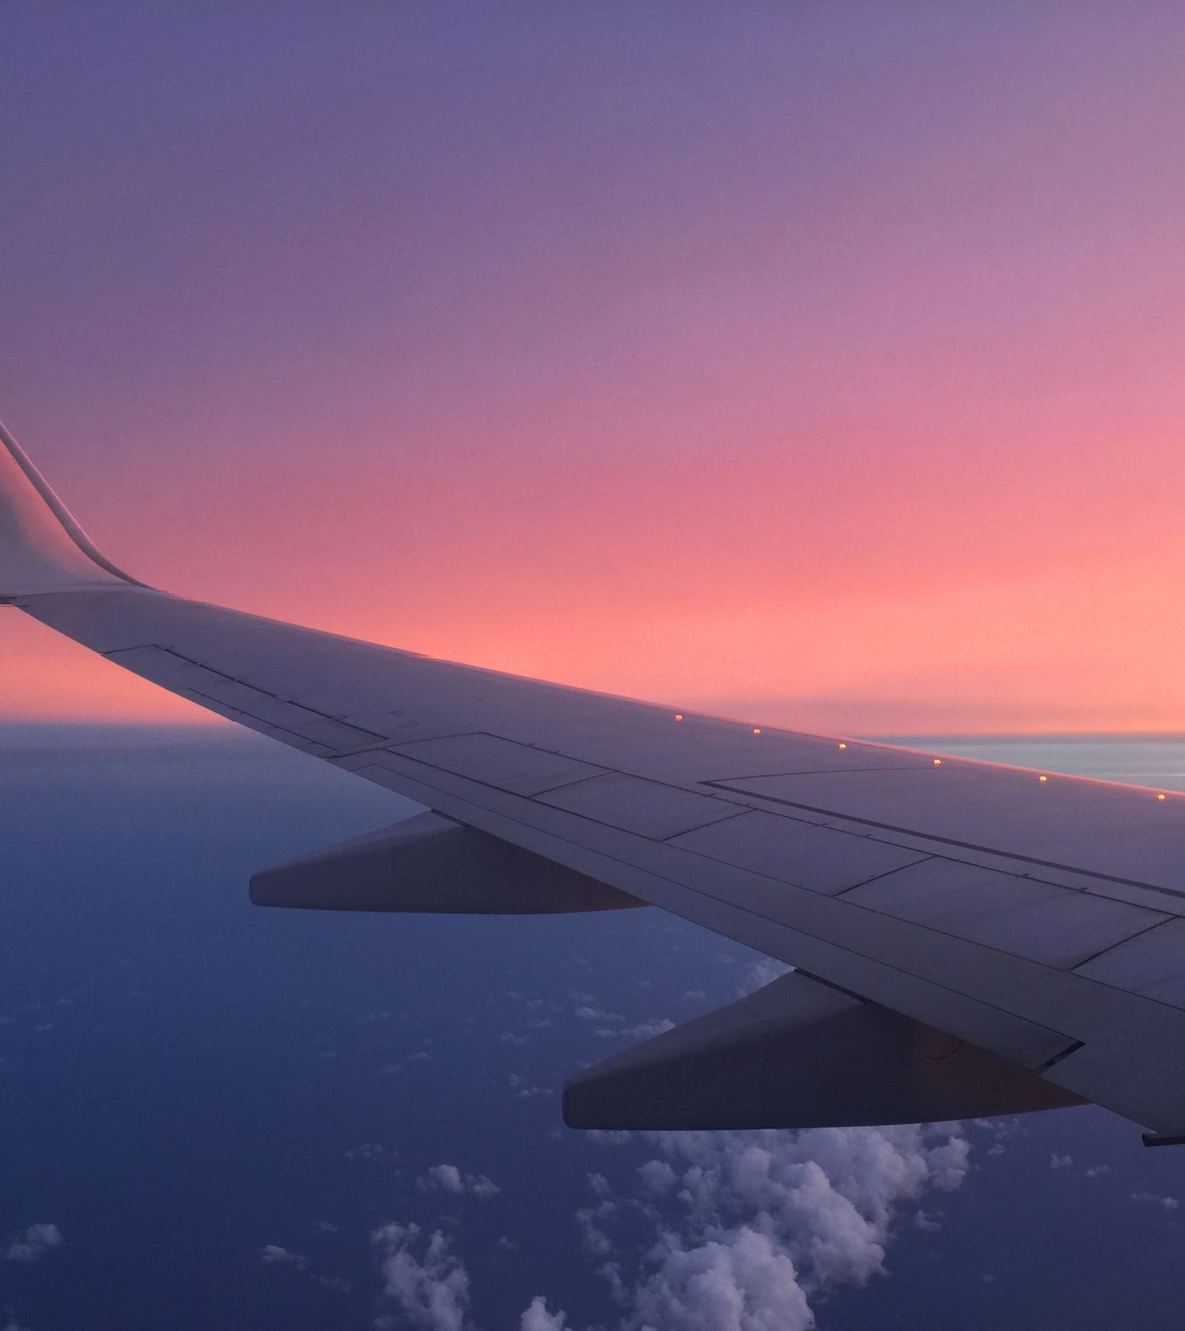
Background
We all want to travel abroad but have noticed significant issues with flight delays.
We know the Australian system does not compensate us for this, and when travelling with kids this is a nightmare!
We wanted to optimise our travel, travel like a local and build our opinion on real life data.

Slide 4
Data Sources
MeteoMatics for Weather Analysis
Amadeus for Flight Data
BTS for U.S. Airports Data from January 2024
GeoApi

Slide 5

Flight On Time Data
Hypothesis:
Flights are more delayed during school holidays

Slide 6
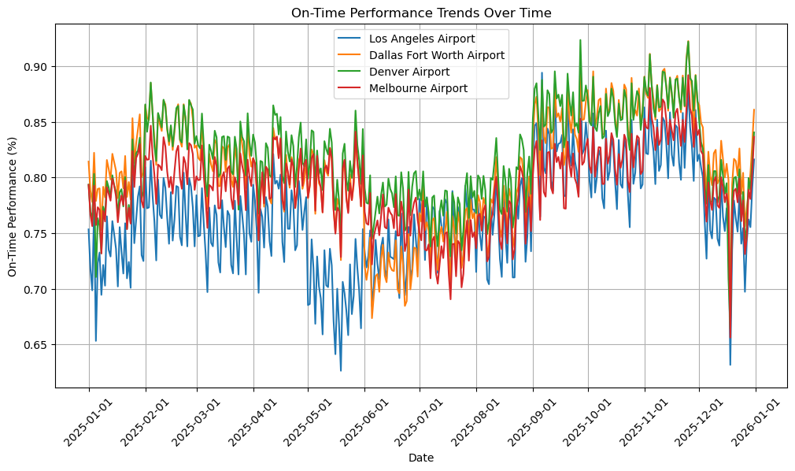

Slide 7
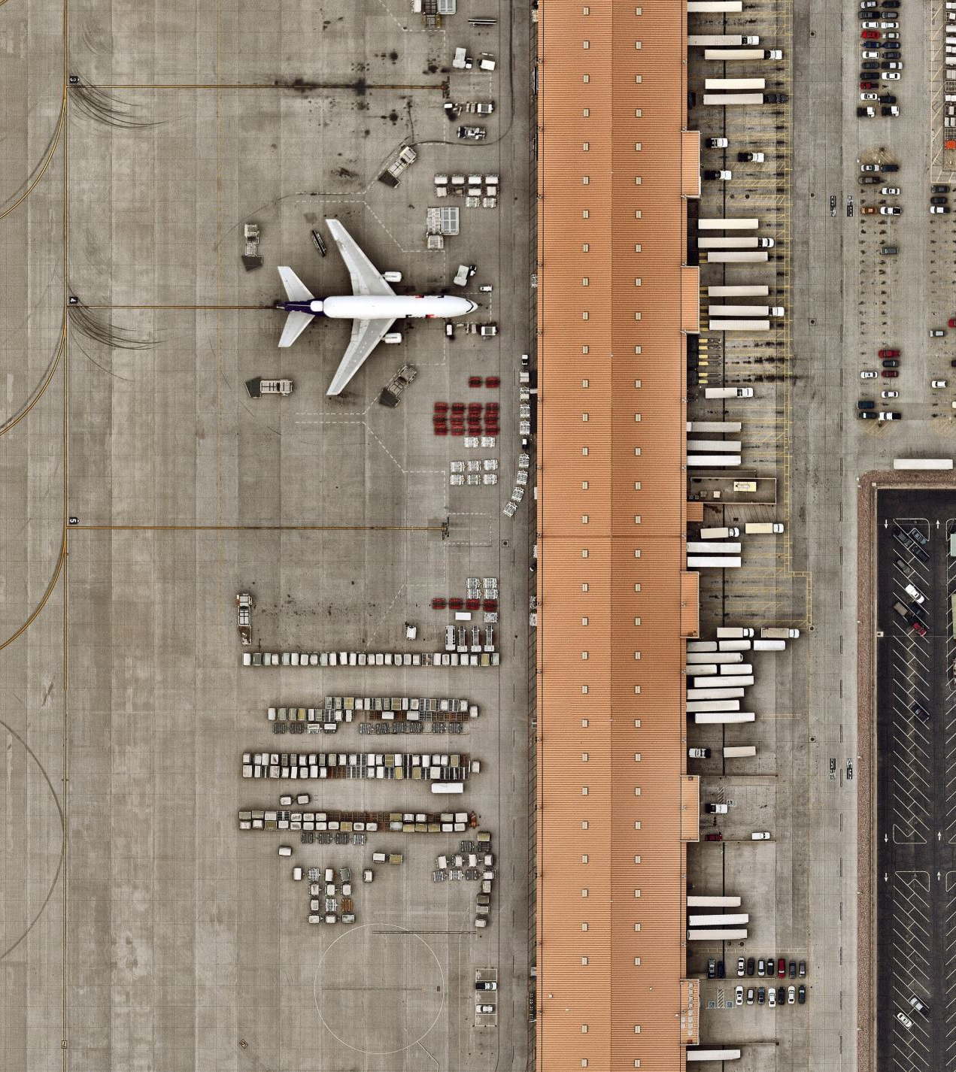
One-way ANOVA
Los Angeles Airport 0.765341
Dallas Fort Worth Airport 0.808250
Denver Airport 0.818672
Melbourne Airport 0.791444
F-Statistic: 101.3218698056186,
P-Value: 1.4396639574560608e-59

Slide 8
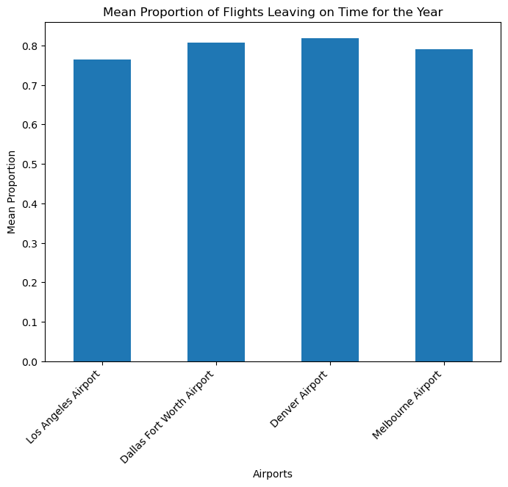

Slide 9
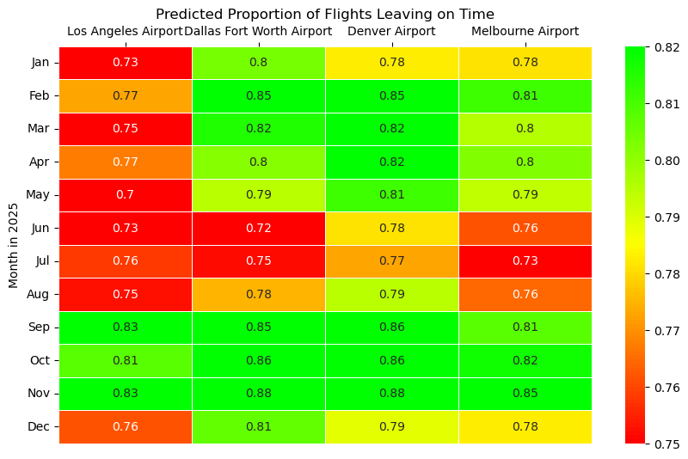

Slide 10
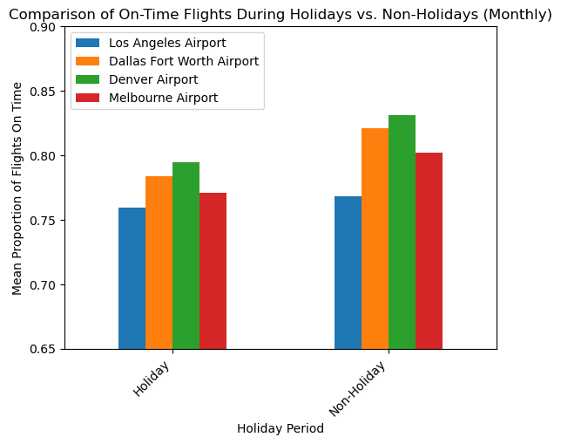
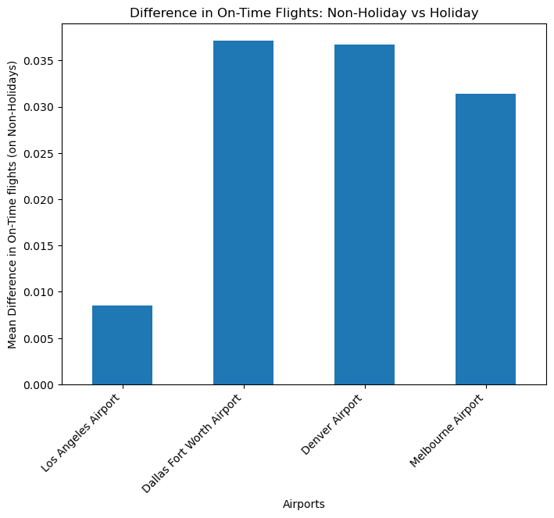

Slide 11
Frequent Destination Data Where do the locals go?

Slide 12
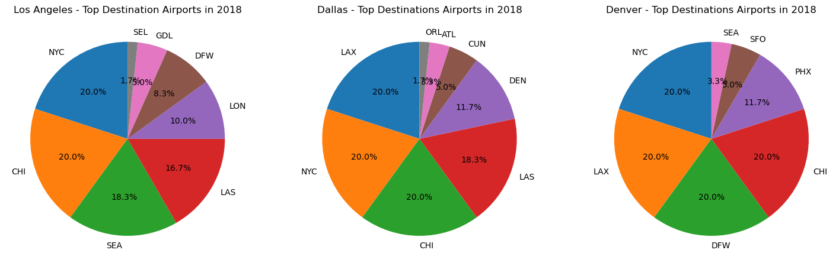

Slide 13
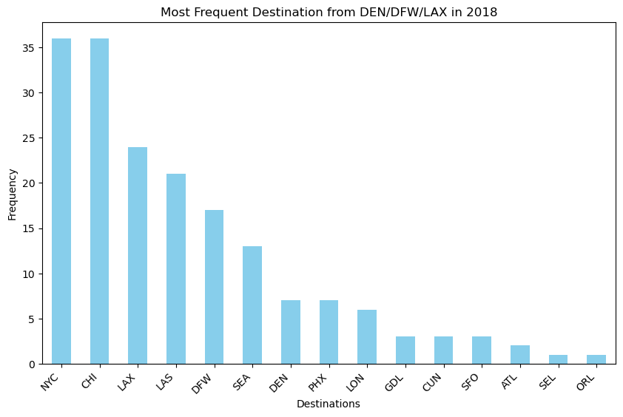

Slide 14
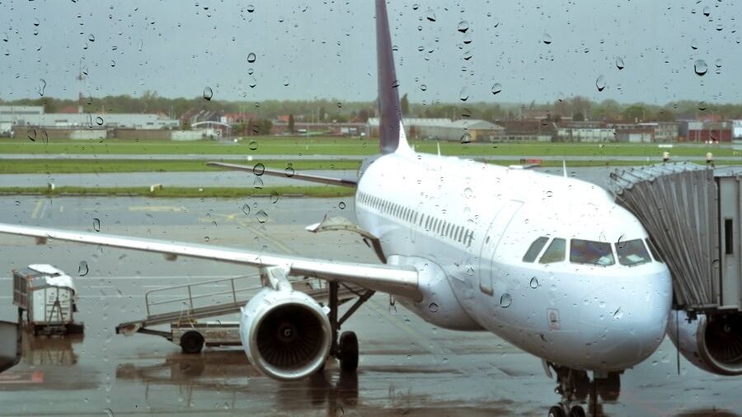
Assessing the Impact of Weather on Flight Delays and Cancellations at U.S. Airports

Slide 15
Key Findings:
Correlation between weather variables
Impact of Wind Speed on Flight Delays
Role of Precipitation in Flight Delays
Impact of Temperature on Flight Delays
Seasonal Trends in Delays/Cancellations
Recommendations for Airlines and Airports

Slide 16
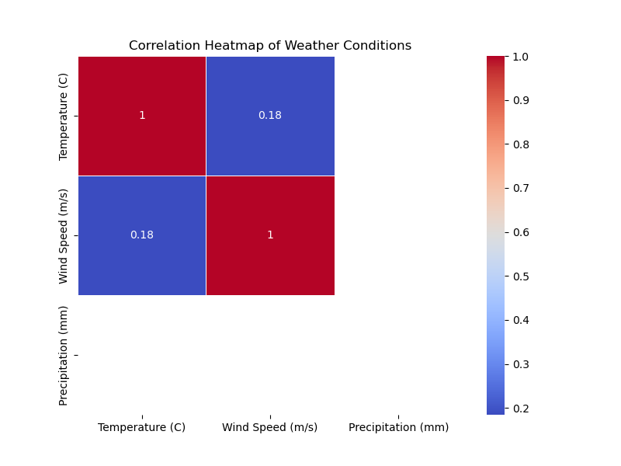
Correlation Between Weather Variables

Slide 17
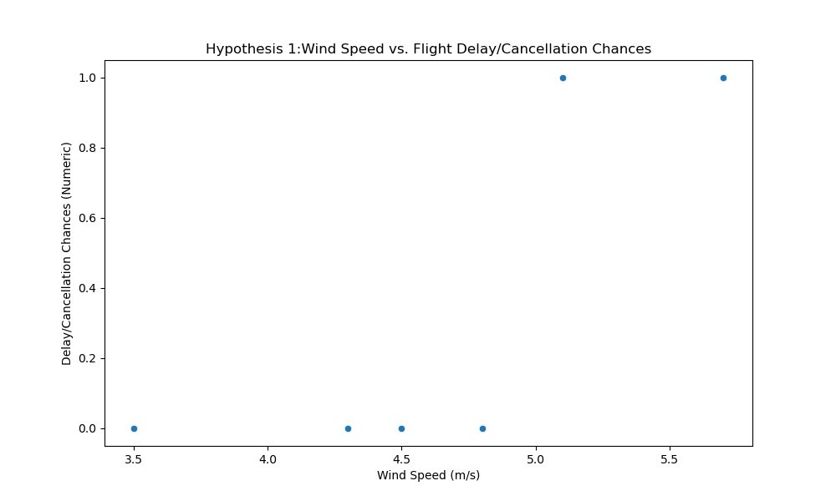
Wind Speed vs. Flight Delays/Cancellations

Slide 18
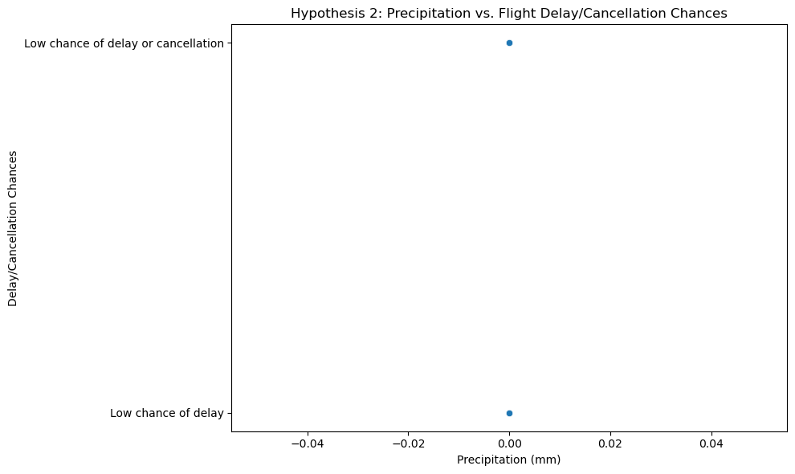
Precipitation vs. Flight Delays/Cancellations

Slide 19
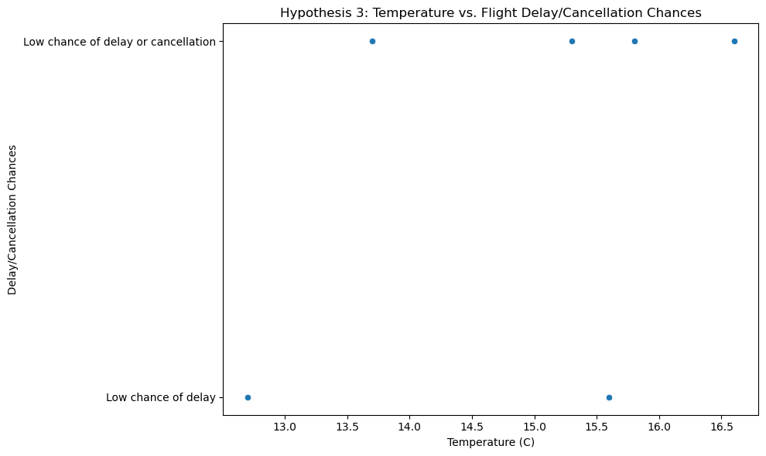
Temperature vs. Flight Delays/Cancellations

Slide 20
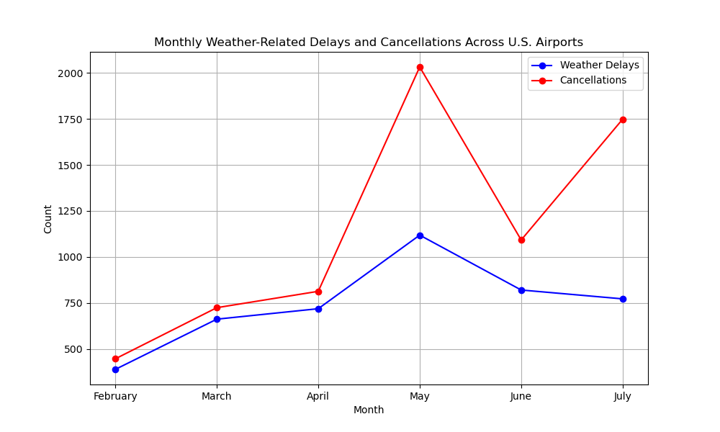
Seasonal/Monthly Weather -related Delays/Cancellations across U.S. Airports

Slide 21
Recommendations
Monitor and Act on Wind Speed Forecasts
Continue Strong Management of Precipitation-Related Disruptions
Enhance Passenger Communication and Flexibility
Invest in Predictive Weather and Delay Models

Slide 22
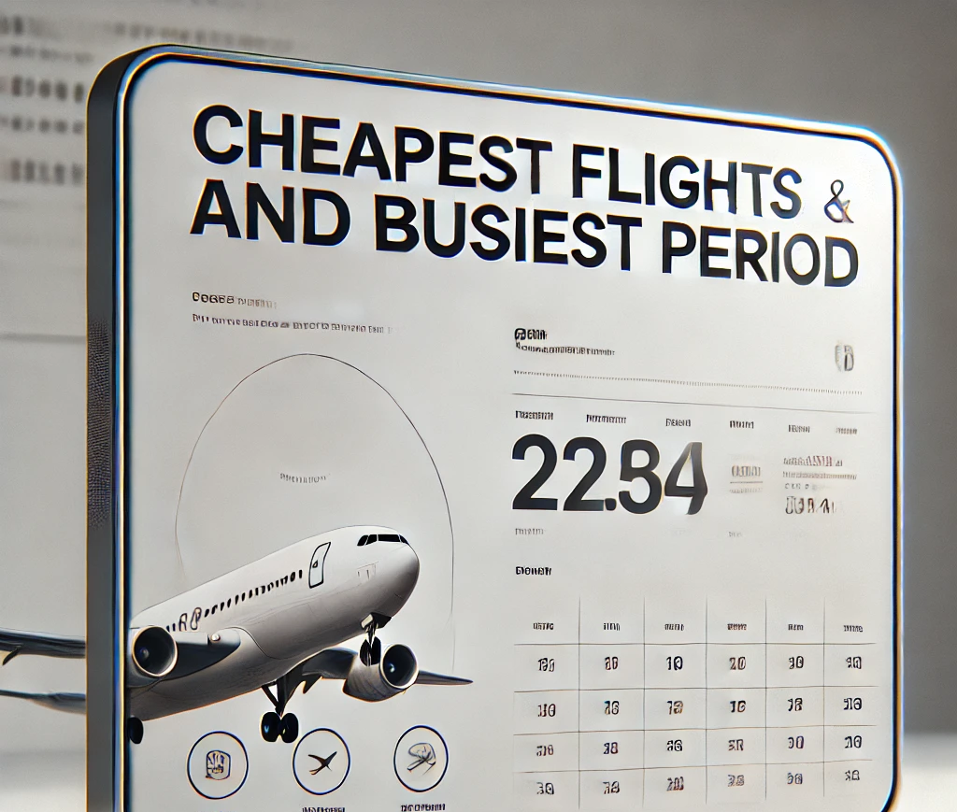
Cheapest Flights
Busiest period

Slide 23
Key Findings: Busiest Travel Months
Busiest Months: January and February (35% of annual travelers), followed by March (30%).
Peak Travel: These months represent a significant portion of yearly travel, indicating strong seasonal trends

Slide 24
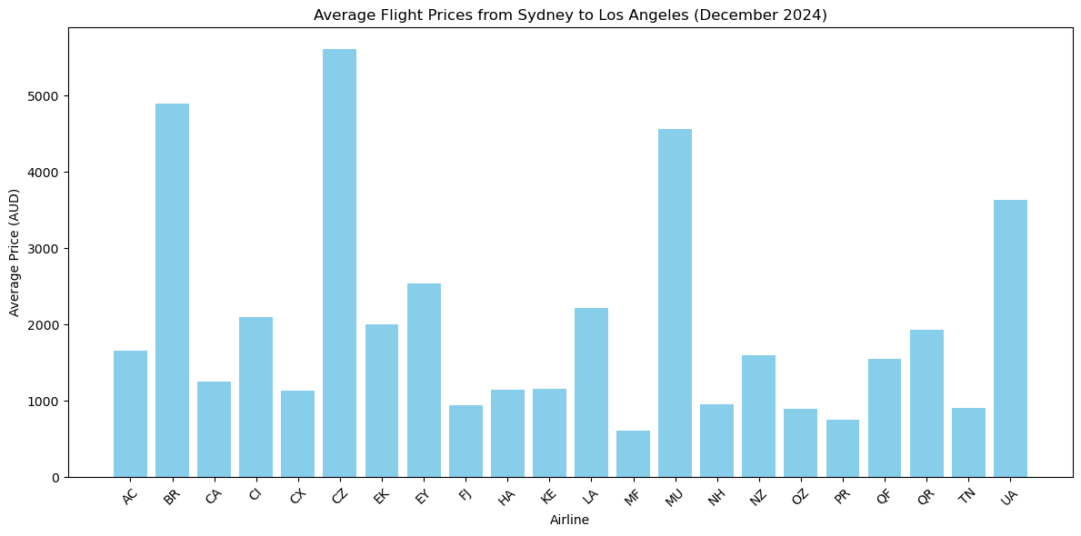

Slide 25
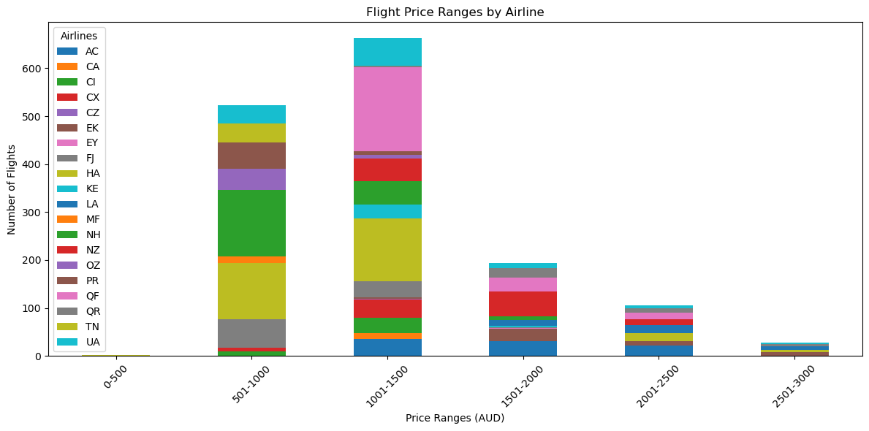

Slide 26
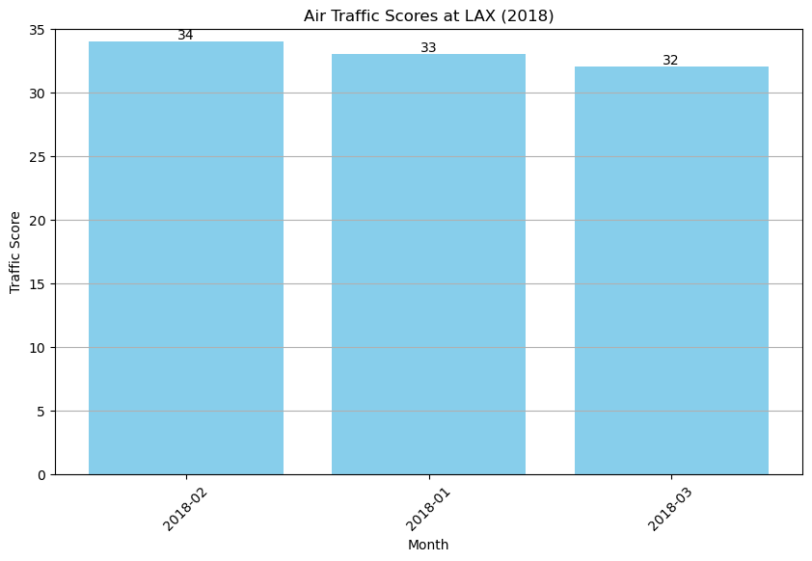

Slide 27
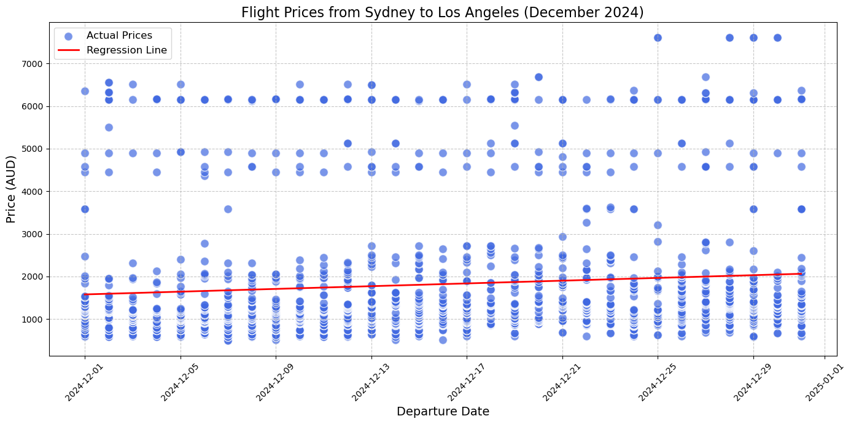

Slide 28


Slide 29
Takeaways!
Flights in the USA appear most efficient in Autumn, away from holidays.
LAX appears to experience more delays than the other airports reviewed.
Travelling like a local means travelling domestic!
Weather causes the most delays and cancellations in Spring and Summer in the USA.
Avoid travelling in July and May as weather patterns are unpredictable.
January and March are the busiest travel months, avoid if you don't like the crowds.
Flights are cheapest at the start of December (Fiji Airways was cheapest! (At least if you're from Sydney))

Slide 30


